Slide 1

Cryptocurrency Heists Unlocking The Secrets Of Blockchain Hacks & Fortifying The Future

Slide 2

$ who am i
Alvin Mwambi (@Steiner254)
Bug Bounty Hunter
Smart Contract Auditor
Swypt Cybersecurity Engr

Slide 3
Agenda
Cryptocurrency Heists.
Fortyifying the future of cryptocurrency.
References.
Q & A.

Slide 4
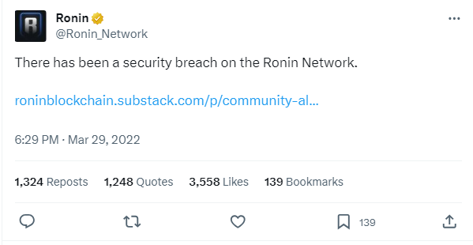
a). Ronin Network

Slide 5
Ronin Network
~ Also referred to as ‘Axie Infinity’.
~ Hacked on 29th March 2022 by North Korean Lazarus Group.
~ $620 million stolen.
~ Lazarus Group gained access to 5 of the 9 private keys held by transaction validators for Ronin Network’s cross-chain bridge.

Slide 6
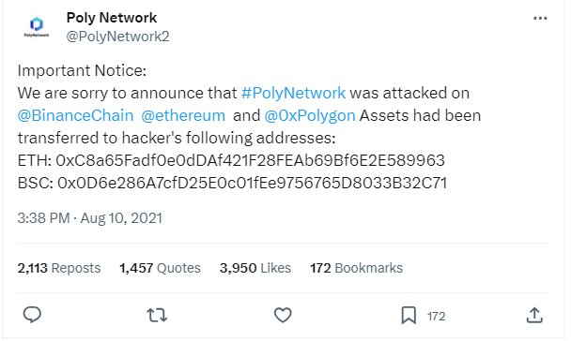
b). Poly Network

Slide 7
Poly Network
~ Hacked on August 2021.
~ $ 610 million was stolen.
~ The hacker said, he did if “for fun” to help Poly Network detect security vulnerabilities.
~ The hacker later on returned the stolen crypto and Poly Network referred him as “Mr. White Hat”.

Slide 8
Poly Network
~ Bug exploited was a mismanagement of access rights btn 2 important Poly Smart Contracts:
EthCrossChainManager
EthCrossChainData
~ Poly offered the hacker a $500,000 bounty & a position – Chief Security Advisor.

Slide 9
Poly Network
~ Later on, Poly Network launched a Public Bug Bounty Program on Immunefi that rewards upto $100,000 for P1 bugs.

Slide 10
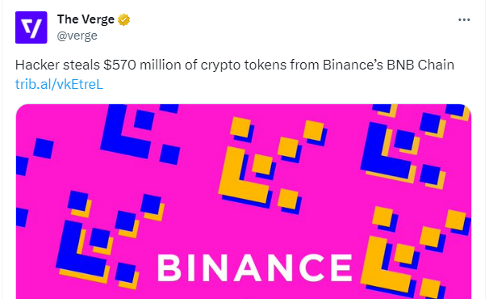
c). Binance

Slide 11
Binance
~ Hacked in October 2022.
~ $570 million stolen from Binance’s BNB chain.

Slide 12
Binance Hack Explained
~ The BSC Token Hub bridge was able to accept forged proof messages created by the attacker.
~ The attacker exploited the BSC Token Hub cross-chain bridge that connects the BNB Beacon Chain/BEP2 and BEP20 chains to steal $570 million.

Slide 13
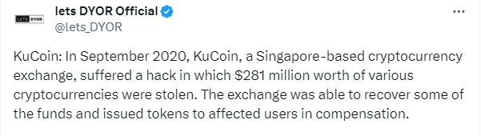
d). KuCoin

Slide 14
KuCoin
~ Hacked on September 2020.
~ $281 million stolen.
~ North Korean hackers (Lazarus Group) managed to obtain private keys to the hot wallets, then exploited by withdrawing large amounts of crypto totaling to $281 million.

Slide 15
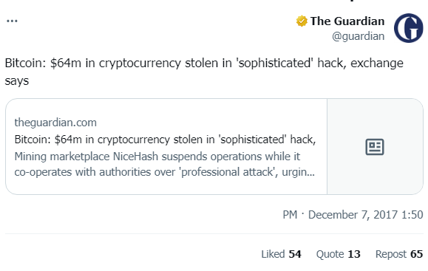
e). NiceHash

Slide 16
NiceHash
~ A crypto mining market.
~ Hacked in December 6th 2017.
~ $64 million stolen.
~ The Lazarus Group used spear phishing attacks to steal $64 million from nicehash.
~ Over several years, nicehash managed to repay/refund all stolen bitcoins to it’s users.

Slide 17

Fortifying the future of crypto

Slide 18
Fortifying the future of crypto
Secure Store Private Keys.
Implement Multi-Signature Wallets.
Regular Security Audits.
Incident Response Plan.
Secure Development Practices.
Employee Training.
User Training.

Slide 19
Fortifying the future of crypto
Keep Software Updated.
Continuous monitoring to detect suspicious activities.

Slide 20
References
https://www.hedgewithcrypto.com/cryptocurrency-exchange-hacks/
https://www.comparitech.com/crypto/biggest-cryptocurrency-heists/
https://creditcoin.org/blog/crypto-hack-prevention/

Slide 21

Q & A - Questions

